Slide 1
Branching and Looping

Slide 2
C if else Statement
The if-else statement in C is used to perform the operations based on some specific condition. The operations specified in if block are executed if and only if the given condition is true.
There are the following variants of if statement in C language.
If statement
If-else statement
If else-if ladder
Nested if

Slide 3
If Statement
The if statement is used to check some given condition and perform some operations depending upon the correctness of that condition. It is mostly used in scenarios where we need to perform different operations for different conditions.
The syntax of the if statement is given below.
if(expression){
//code to be executed
}

Slide 4
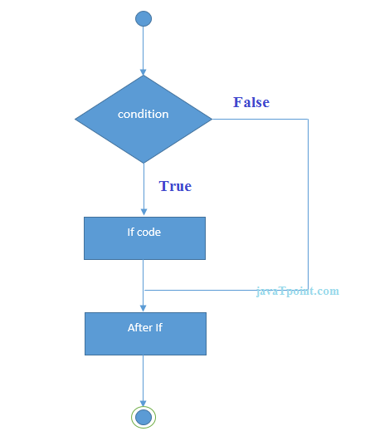
Flowchart of if statement in C

Slide 5
#include<stdio.h>
int main(){
int number=0;
printf("Enter a number:");
scanf("%d",&number);
if(number%2==0){
printf("%d is even number",number);
}
printf(“Finished”);
return 0;
}

Slide 6
If-else Statement
The if-else statement is used to perform two operations for a single condition.
The if-else statement is an extension to the if statement using which, we can perform two different operations, i.e., one is for the correctness of that condition, and the other is for the incorrectness of the condition.
Here, we must notice that if and else block cannot be executed simultaneously.
Using an if-else statement is always preferable since it always invokes an otherwise case with every if condition. The syntax of the if-else statement is given below.
if(expression){
//code to be executed if condition is true
}else{
//code to be executed if condition is false
}

Slide 7
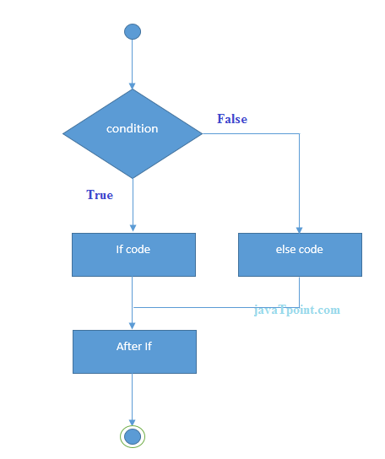
Flowchart of the if-else statement in C

Slide 8
#include<stdio.h>
int main(){
int number=0;
printf("enter a number:");
scanf("%d",&number);
if(number%2==0){
printf("%d is even number",number);
}
else{
printf("%d is odd number",number);
}
printf(“Finished”);
return 0;
}

Slide 9
If else-if ladder Statement
The if-else-if ladder statement is an extension of the if-else statement.
It is used in the scenario where there are multiple cases to be performed for different conditions.
In the if-else-if ladder statement, if a condition is true then the statements defined in the if block will be executed, otherwise if some other condition is true then the statements defined in the else-if block will be executed, at the last if none of the conditions is true then the statements defined in the else block will be executed.
There are multiple else-if blocks possible. It is similar to the switch case statement where the default is executed instead of the else block if none of the cases is matched.

Slide 10
Syntax
if(condition1){
//code to be executed if condition1 is true
}
else if(condition2){
//code to be executed if condition2 is true
}
else if(condition3){
//code to be executed if condition3 is true
}
...
else{
//code to be executed if all the conditions are false
}

Slide 11
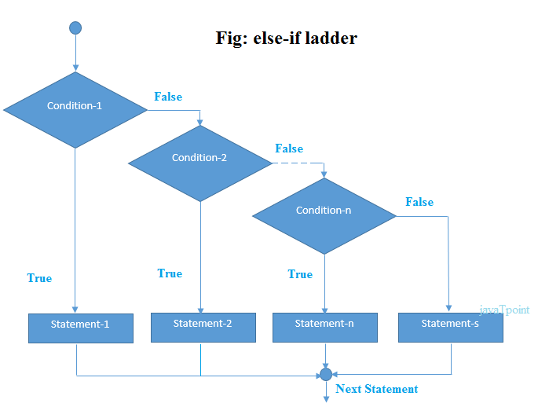

Slide 12
#include<stdio.h>
int main(){
int number=0;
printf("enter a number:");
scanf("%d",&number);
if(number==10){
printf("number is equals to 10");
}
else if(number==50){
printf("number is equal to 50");
}
else if(number==100){
printf("number is equal to 100");
}
else{
printf("number is not equal to 10, 50 or 100");
}
return 0;
}

Slide 13
nested if statements
It is always legal in C programming to nest if-else statements, which means you can use one if or else if statement inside another if or else if statement(s).
Syntax
The syntax for a nested if statement is as follows −
if( boolean_expression 1)
{
/* Executes when the boolean expression 1 is true */
if(boolean_expression 2)
{
/* Executes when the boolean expression 2 is true */
}
}

Slide 14
#include <stdio.h>
int main () {
/* local variable definition */
int a = 100;
int b = 200;
/* check the boolean condition */
if( a == 100 ) {
/* if condition is true then check the following */
if( b == 200 ) {
/* if condition is true then print the following */
printf("Value of a is 100 and b is 200\n" );
}
}
printf("Exact value of a is : %d\n", a );
printf("Exact value of b is : %d\n", b );
return 0;
}

Slide 15
C Switch Statement
The switch statement in C is an alternate to if-else-if ladder statement which allows us to execute multiple operations for the different possible values of a single variable called switch variable.
Here, We can define various statements in the multiple cases for the different values of a single variable.

Slide 16
The syntax of switch statement in c language is given below:
switch(expression){
case value1:
//code to be executed;
break; //optional
case value2:
//code to be executed;
break; //optional
......
default:
code to be executed if all cases are not matched;
}

Slide 17
Rules for switch statement in C language
The switch expression must be of an integer or character type.
The case value must be an integer or character constant.
The case value can be used only inside the switch statement.
The break statement in the switch case is not mandatory. It is optional.
If there is no break statement found in the case, all the cases will be executed after the matched case. It is known as fall through the state of C switch statement.

Slide 18
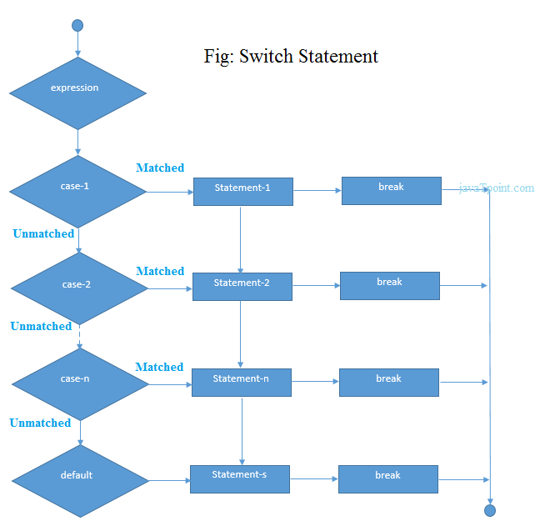
Flowchart of switch statement in C

Slide 19
#include <stdio.h>
int main() {
int num = 2;
switch (num) {
case 1:
printf("Value is 1\n");
break;
case 2:
printf("Value is 2\n");
break;
case 3:
printf("Value is 3\n");
break;
default:
printf("Value is not 1, 2, or 3\n");
break;
}
return 0;
}

Slide 20
Break and Default keyword in Switch statement
Let us explain and define the "break" and "default" keywords in the context of the switch statement, along with example code and output.
1. Break Keyword:
The "break" keyword is used within the code block of each case to terminate the switch statement prematurely. When the program encounters a "break" statement inside a case block, it immediately exits the switch statement, preventing the execution of subsequent case blocks. The "break" statement is crucial for avoiding switch statements' "fall-through" behavior.

Slide 21
2. Default Keyword:
If no matching case exists and a "default" case exists, the code block associated with the "default" case is run.

Slide 22
C Loops
Why use loops in C language?
The looping simplifies the complex problems into the easy ones. It enables us to alter the flow of the program so that instead of writing the same code again and again, we can repeat the same code for a finite number of times.
For example, if we need to print the first 10 natural numbers then, instead of using the printf() statement 10 times, we can print inside a loop that runs up to 10 iterations.
Advantage of loops in C
1) It provides code reusability.
2) Using loops, we do not need to write the same code again and again.
3) Using loops, we can traverse over the elements of data structures (array or linked lists).
Types of C Loops
Three types of loops in C language is given below:
do-while
while
for

Slide 23
do-while loop in C
The do-while loop continues until a given condition is satisfied.
It is also called a post-tested loop.
It is used when it is necessary to execute the loop at least once (mostly menu-driven programs).
The syntax of the do-while loop in c language is given below:
do{
//code to be executed
}while(condition);

Slide 24
#include <stdio.h>
int main() {
Int i = 1;
do {
printf("%d\n", i);
i++;
} while (i<= 5);
return 0;
}

Slide 25
while loop in C
The while loop in c is to be used in the scenario where we don't know the number of iterations in advance.
The block of statements is executed in the while loop until the condition specified in the while loop is satisfied.
It is also called a pre-tested loop.
The syntax of the while loop in c language is given below:
while(condition){
//code to be executed
}

Slide 26
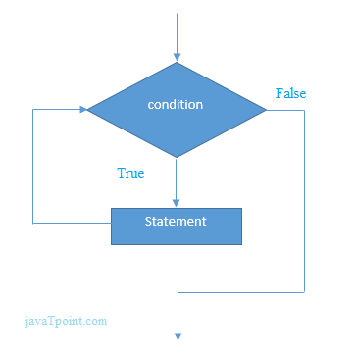

Slide 27
#include<stdio.h>
int main()
{
int i=1;
while(i<=10)
{
printf("%d \n",i);
i++;
}
return 0;
}

Slide 28
Properties of while loop
A conditional expression is used to check the condition.
The statements defined inside the while loop will repeatedly execute until the given condition fails.
The condition will be true if it returns a 1 or non-zero number. The condition will be false if it returns zero.
In the while loop, the condition expression is compulsory.
Running a while loop without a body is possible.
We can have more than one conditional expression in a while loop.
If the loop body contains only one statement, then the braces are optional.

Slide 29
Infinitive while loop in C
If the expression passed in while loop results in any non-zero value then the loop will run the infinite number of times.
while(1){
//statement
}

Slide 30
for loop in C
The for loop in C language is used to iterate the statements or a part of the program several times.
It is frequently used to traverse the data structures like the array and linked list.
The syntax of for loop in c language is given below:
for(Expression 1; Expression 2; Expression 3)
{
//code to be executed
}

Slide 31
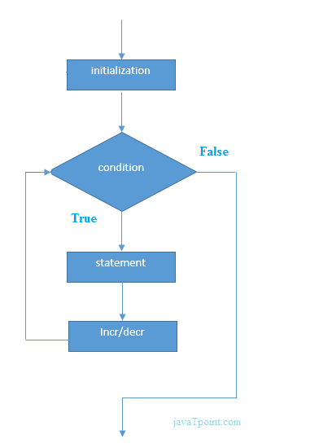

Slide 32
C for loop Examples
Let's see the simple program of for loop that prints table of 1.
#include<stdio.h>
int main(){
int i=0;
for(i=1;i<=10;i++)
{
printf("%d \n",i);
}
return 0;
}

Slide 33
Properties of Expression 1
The expression represents the initialization of the loop variable.
We can initialize more than one variable in Expression 1.
Expression 1 is optional.

Slide 34
#include <stdio.h>
int main()
{
int a,b,c;
for(a=0,b=12,c=23;a<2;a++)
{
printf("%d ",a+b+c);
}
}

Slide 35
#include <stdio.h>
int main()
{
int i=1;
for(;i<5;i++)
{
printf("%d ",i);
}
}

Slide 36
Properties of Expression 2
Expression 2 is a conditional expression. It checks for a specific condition to be satisfied. If it is not, the loop is terminated.
Expression 2 can have more than one condition. However, the loop will iterate until the last condition becomes false. Other conditions will be treated as statements.
Expression 2 is optional.
Expression 2 can perform the task of expression 1 and expression 3.
That is, we can initialize the variable as well as update the loop variable in expression 2 itself.
We can pass zero or non-zero values in expression 2. However, in C, any non-zero value is true, and zero is false by default.

Slide 37
#include <stdio.h>
int main()
{
int i;
for(i=0;i<=4;i++)
{
printf("%d ",i);
}
}

Slide 38
#include <stdio.h>
int main()
{
int i,j,k;
for(i=0,j=0,k=0;i<4,k<8,j<10;i++)
{
printf("%d %d %d\n",i,j,k);
j+=2;
k+=3;
}
}

Slide 39
Properties of Expression 3
Expression 3 is used to update the loop variable.
We can update more than one variable at the same time.
Expression 3 is optional.

Slide 40
#include<stdio.h>
void main ()
{
int i=0,j=2;
for(i = 0;i<5;i++,j=j+2)
{
printf("%d %d\n",i,j);
}
}

Slide 41
Loop body
The braces {} are used to define the scope of the loop.
However, if the loop contains only one statement, then we don't need to use braces.
A loop without a body is possible. The braces work as a block separator, i.e., the value variable declared inside for loop is valid only for that block and not outside. Consider the following example.
#include<stdio.h>
void main ()
{
int i;
for(i=0;i<10;i++)
{
int i = 20;
printf("%d ",i);
}
}

Slide 42
Infinitive for loop in C
To make a for loop infinite, we need not give any expression in the syntax. Instead of that, we need to provide two semicolons to validate the syntax of the for loop. This will work as an infinite for loop.
#include<stdio.h>
void main ()
{
for(;;)
{
printf("welcome ");
}
}

Slide 43
What is the Continue Statement in C?
The continue statement is used to skip the current iteration of any loop and bring the control to the beginning of the iteration.
The statements following the continue statement are skipped and the iteration starts again.

Slide 44
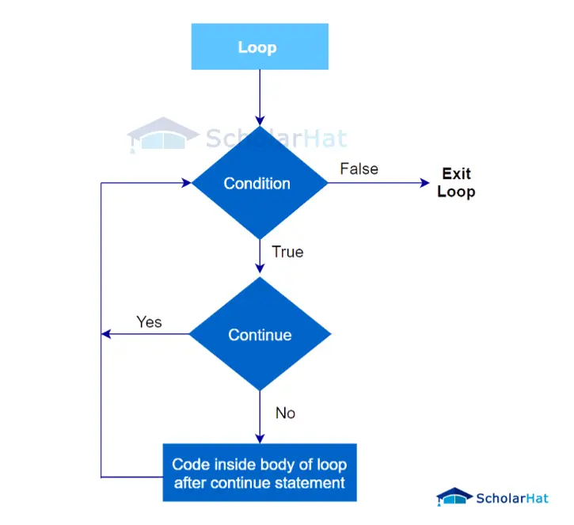

Slide 45
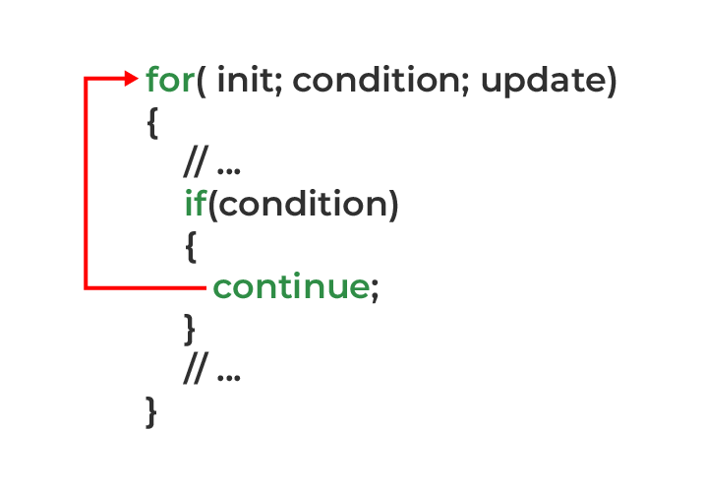

Slide 46
Syntax
//loop statements
continue;
//some lines of the code which is to be skipped

Slide 47
Example of Continue Statement in C
#include<stdio.h>
void main ()
{
for (int i = 1; i <= 10; i++) {
if (i == 5) {
continue;
}
printf("%d\n", i);
}

Slide 48
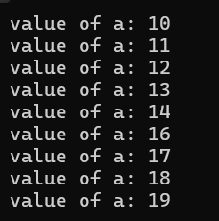
include <stdio.h>
int main () {
/* local variable definition */
int a = 10;
/* do loop execution */
do {
if( a == 15) {
/* skip the iteration */
a = a + 1;
continue;
}
printf("value of a: %d\n", a);
a++;
} while( a < 20 );
return 0;
}

Slide 49
What is the Break Statement in C?
If you remember we already came across the break statement while learning the switch statement. We used to check each case in switch and after finding the correct match used to get out using break.
It is one of the most used jump statements.
In C, break is used to prematurely exit from a loop or switch statement, before the block has been fully executed.
As soon as a break statement is encountered inside a loop, the loop terminates immediately, and control is transferred to the next statement outside the loop.

Slide 50
Syntax
//loop or switch case
break;

Slide 51
Example of Break Statement in C
#include <stdio.h>
int main()
{
for(int i=1; i <=10; i++)
{
if(i == 5)
{
break; // terminates the loop when i is equal to 5
}
printf("%d\n", i);
}
return 0;
}

Slide 52
Example of Break statement in a for loop
#include<stdio.h>
void main ()
{
int i = 0;
while(1)
{ printf("%d\n",i);
i++;
if(i == 5)
break;
}
printf("The loop terminates");
}

